Slide 1

ChatGPT Positioning Strategy
By Team 5

Slide 2
ChatGPT's Positioning Summary
This positioning analysis evaluates ChaptGPT and its competitors (DeepSeek, Gemini, Copilot, and Claude) derived from perceptual and preference data. This analysis is based on attributes such as Ease of Use and Speed of Response being the dominant dimensions explaining variance of about 99.8% .
ChaptGPT leads the AI assistant market, dominating key perceptual dimensions: "Ease of Use & Speed of Response" (Dimension 1) and "Response Accuracy & Innovation" (Dimension 2). Despite strong competition, consumer preference (7.74) is significantly higher than competitors like Copilot (4.18) and DeepSeek (3.92).
Trustworthiness remains a challenge across all AI models, presenting an opportunity for differentiation.
To sustain market leadership, ChaptGPT should reinforce its strengths while addressing trust concerns. A tiered pricing strategy (Freemium + Premium $20-$25/month) will maintain accessibility while monetizing high-value users.
Strategic Focus: Leverage Leadership in terms of Usability & Speed – Maintain product superiority. Strengthen Trustworthiness – Transparency & AI safety initiatives. Differentiate from Free Competitors (DeepSeek) – Highlight premium features & reliability. Adopt Smart Pricing – Justify premium pricing while offering entry-level access.
Bottom Line: ChaptGPT is the clear market leader but must proactively enhance trust and optimize pricing to sustain dominance.

Slide 3
Present Conditions of the Main Brand and Its Rivals
Competitor Analysis
ChaptGPT (Focal Brand)
Strongest brand across all perceptual attributes.
Highest preference score (7.74), indicating strong user adoption.
Positioned far from competitors on the perceptual map, indicating strong differentiation.
Brand | Key Strengths | Key Weaknesses
DeepSeek (Free Model) | Moderate Creativity (3.05) | Low Trustworthiness (2.8), No Differentiation
Gemini | Decent Speed (2.92) | Weak Accuracy (2.76), Low Ease of Use (2.85)
Copilot | Moderate Speed (3.1) | Low Trustworthiness (2.93)
Claude | None (weak in all areas) | Lowest Accuracy (2.5), Lowest Preference (3.46)

Slide 4
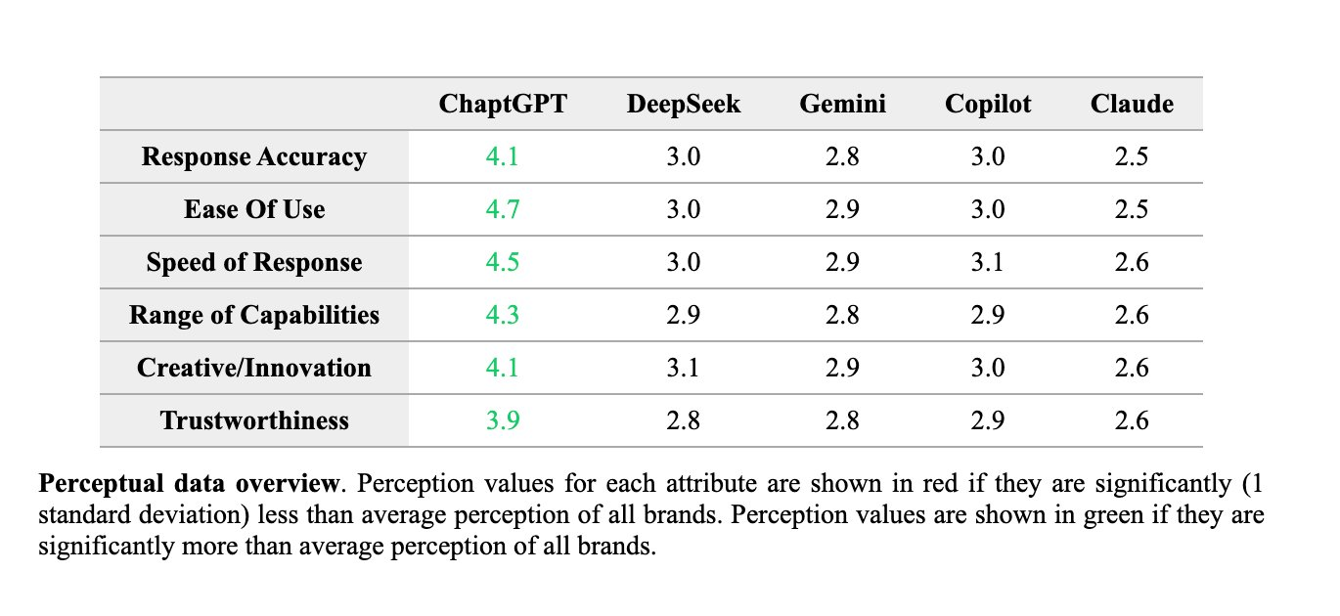
Collection of Perceptual Data
Measures consumer perception of each brand based on attributes
Aggregated data (Averages for each brand)
Google forms survey
75 people (Responded)
39 people (After data cleaning)
Perceptual Data Collection Question
For each attribute below, please rate ChatGPT and its competitors:
1 (Much Worse) to 7 (Much Better)

Slide 5
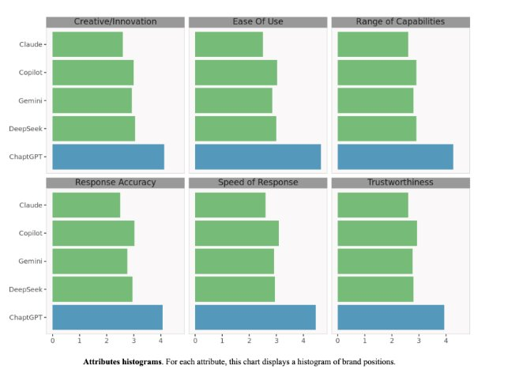

Slide 6
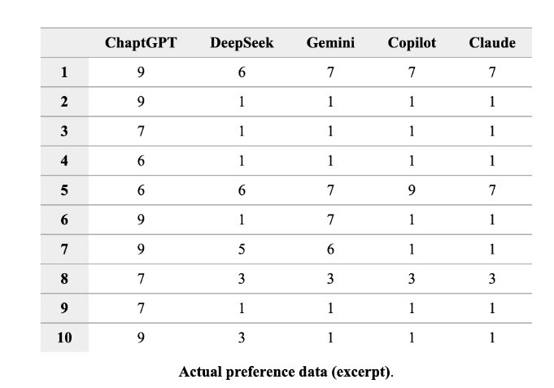
Collection of Preference Data
Measures consumer ratings of focal brand and competing brand
Individual preference data
Google Forms Survey
75 people (Responded)
39 people (After data cleaning)
Preference Data Collection Question
Please indicate your overall preference for each AI chatbot on a scale:
1 (Not Preferred at All) to 9 (Highly Preferred)

Slide 7
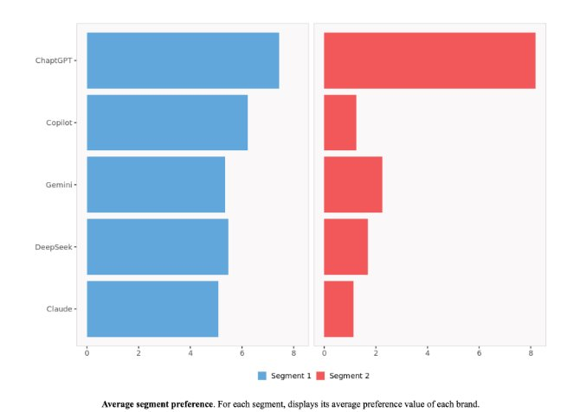

Slide 8
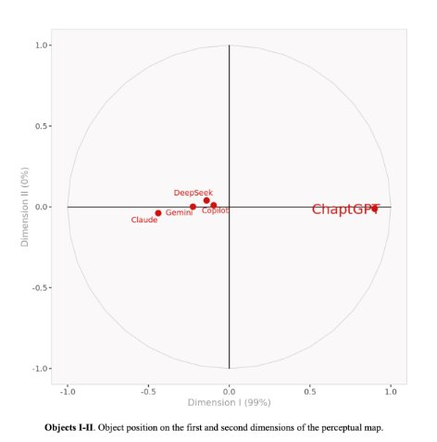
Positioning Map Derivation
To visualize how ChaptGPT and its competitors are perceived in the market, a Positioning Map was created using Principal Component Analysis (PCA). This technique reduces dimensionality while preserving the most relevant information from consumer perception data.
Key Steps in Derivation:
Data Processing:
Perceptual data was collected across six key attributes (Ease of Use, Speed of Response, Response Accuracy, Range of Capabilities, Creativity/Innovation, and Trustworthiness).
Preference data was integrated to enhance accuracy.
Dimensionality Reduction with PCA:
PCA was applied to transform the six-dimensional perceptual data into two principal dimensions.
The first two dimensions explain 99.8% of the total variance, meaning they capture nearly all meaningful differences between AI models.
Final Dimensions Identified:
Dimension 1 → "Ease of Use & Speed of Response" (Primary usability factors).
Dimension 2 → "Response Accuracy & Innovation" (Accuracy, Trustworthiness & Creativity).
Object Plotting:
Each AI model was positioned based on how consumers rated them across these two dimensions.
ChaptGPT is positioned furthest along Dimension 1, confirming its leadership in usability and speed.
DeepSeek, Gemini, and Copilot cluster together, indicating limited differentiation.

Slide 9
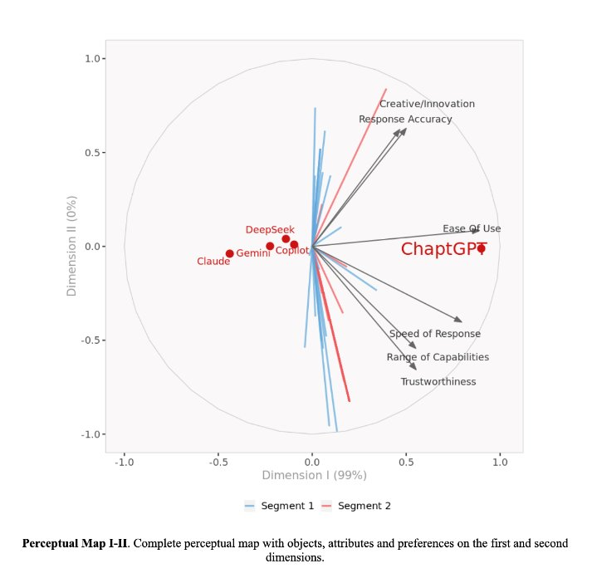
🔍 Key Insights from Positioning Analysis (with Preferential Segmentation)
ChaptGPT is the market leader, positioned significantly ahead of competitors in both key dimensions:
Ease of Use & Speed of Response (Dimension 1)
Response Accuracy & Innovation (Dimension 2)
DeepSeek, despite being free, lacks differentiation in core attributes, making it less competitive.
Speed of Response and Ease of Use are the strongest differentiators that drive consumer preference.
ChaptGPT leads in both, making it the most preferred AI model (7.74 average preference).
Gemini, Copilot, and DeepSeek cluster closely, indicating similar user perception and weaker differentiation.
Trustworthiness is a weak spot across all AI models, including ChaptGPT (3.93). This presents an opportunity for differentiation through transparency & reliability improvements.
Two consumer segments were identified based on preference data:
Segment 1 prefers ChaptGPT but is open to alternatives.
Segment 2 is highly loyal to ChaptGPT, with an 8.19 avg preference, justifying a premium pricing strategy.

Slide 10
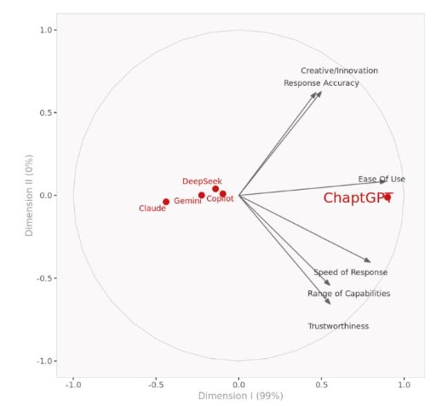
Further, Analysis of the Competitive Environment and Positioning
ChatGPT is distinctly positioned
Aligned with key attributes
Other brands are clustered together
Excels at multiple attributes
Ease of Use
Speed of Response
Range of Capabilities
Hardly any differentiation in other brands
Trustworthiness
All brands struggled with this attribute signaling need for improvement
DeepSeek has only been around for little time
Outperforming most AI brands

Slide 11

Recommendations for ChatGPT
Based on the Positioning Analysis and Perceptual Map insights, ChaptGPT is the market leader but must take proactive steps to sustain its dominance, improve trust perception, and differentiate from free competitors like DeepSeek.
Reinforce Market Leadership
Optimize UI/UX & response speed for better user experience.
Leverage consumer loyalty (Segment 2) with exclusive features.
Expand AI innovation & capabilities to maintain competitive edge.
Enhance Trustworthiness
Improve transparency & AI reliability (explainable AI, fact-checking).
Introduce bias mitigation & data security measures.
Partner with trusted institutions to strengthen credibility.
Differentiate from Free Competitors (DeepSeek)
Highlight superior accuracy, speed, and premium features.
Offer AI-powered customization & developer integrations
Optimize Pricing Strategy
Maintain Freemium + Premium ($20-$25/month) model.
Provide student & enterprise-tier pricing for wider adoption.
Expand Market Reach
Increase AI awareness through education & marketing campaigns.
Expand regional support & emerging markets for growth.

Slide 12
Limitations
Sample Size Constraints
The analysis is based on ~39 survey responses, which may not be fully representative of the broader AI market.
A larger sample could provide more statistical reliability and diverse consumer insights.
Subjectivity in Perception Data
Perceptual ratings are subjective and influenced by personal biases.
Some respondents may be more familiar with certain brands, impacting ratings.
Competitor Pricing Not Considered
The analysis does not directly account for competitor pricing models, which can impact consumer choice.
Free models like DeepSeek may attract users despite lower perceptual scores.
Limited Dimensions in Positioning Map
Only the top two dimensions (Ease of Use & Speed of Response, Accuracy & Innovation) were considered.
Other factors like customer support, ethical AI concerns, or integrations were not included.
Market Trends & External Factors
The analysis does not account for future AI advancements, regulatory changes, or shifting consumer preferences.
New competitors or improvements in existing models could alter the market landscape

Slide 13
Key Takeaways
DeepSeek (Free Model) Lacks Competitive Strength
Despite being free, it fails to differentiate in Accuracy, Innovation, and Trustworthiness.
Users still prefer ChaptGPT, indicating that quality trumps cost in AI adoption.
Ease of Use & Speed of Response Are Critical Differentiators
Consumers value intuitive design and fast response times over other factors.
ChaptGPT should continue to invest in seamless user experience and AI efficiency.
Trustworthiness is a Market-Wide Weakness
All AI models scored low in Trustworthiness, including ChaptGPT (3.93).
This presents an opportunity for differentiation through transparency, security, and responsible AI policies.
Segmented Consumer Preferences Exist
Segment 1 is open to alternatives, meaning competitors could gain ground if they improve.
Segment 2 is highly loyal to ChaptGPT (8.19 avg preference), reinforcing the justification for premium pricing.

Slide 14
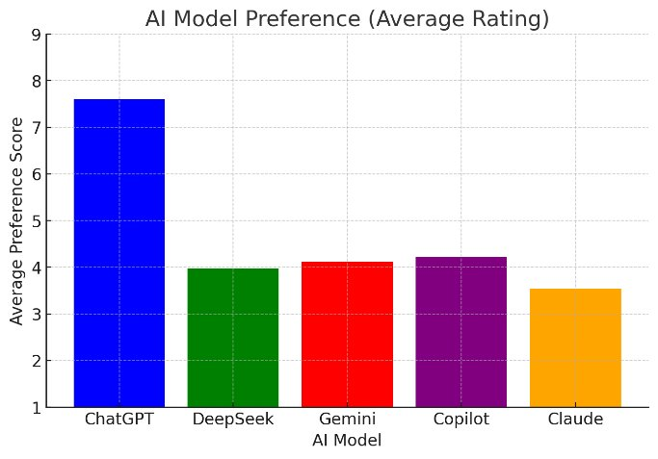

Slide 15
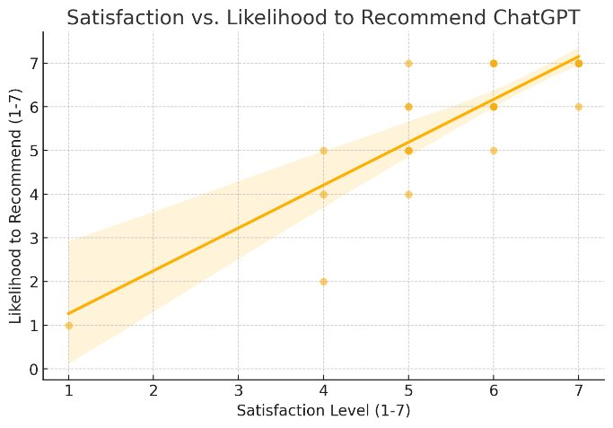

Slide 16
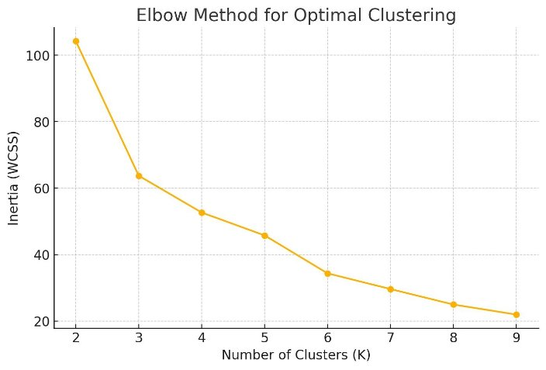
Cluster Analysis Insights, 1 (Not Preferred at All) to 9 (Highly Preferred)
Cluster | ChatGPT | DeepSeek | Gemini | Copilot | Claude | 12. Likelihood to Recommend 1 = Not at all likely, 7 = Extremely likely)
0 | 8.38 | 1.84 | 2.53 | 1.30 | 1.15 | 6.61
1 | 7.875 | 5.9375 | 5.5625 | 6.125 | 5.375 | 6.5
2 | 4.0 | 1.0 | 1.0 | 3.0 | 1.0 | 2.33
Cluster 0 (ChatGPT Enthusiasts):
High preference for ChatGPT (8.38 average rating).
Very low preference for competitors (DeepSeek, Gemini, Copilot, Claude).
Extremely high likelihood to recommend ChatGPT (6.6/7).
Cluster 1 (Multi-Model Users):
Moderate preference for ChatGPT (7.87).
Strong preferences for DeepSeek, Gemini, Copilot, and Claude.
High likelihood to recommend ChatGPT (6.5/7), but also considers alternatives.
Cluster 2 (Skeptics/Low-Engagement Users):
Low preference for all AI models, including ChatGPT (4.0).
Unlikely to recommend ChatGPT (2.3/7).
May have had negative experiences or are disengaged users.

Slide 17
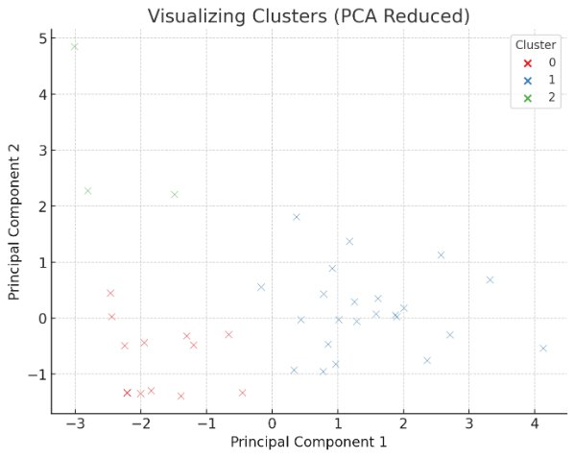
Cluster 0 (Frequent Professional Users) consists of younger professionals who use AI tools multiple times a week and have a mid-range income.
Cluster 1 (Daily Student Users) shows strong engagement among students with lower income levels but higher education.
Cluster 2 (Low-Engagement Users) appears to be professionals who either don't engage with AI tools or may have dropped off usage.

Slide 18
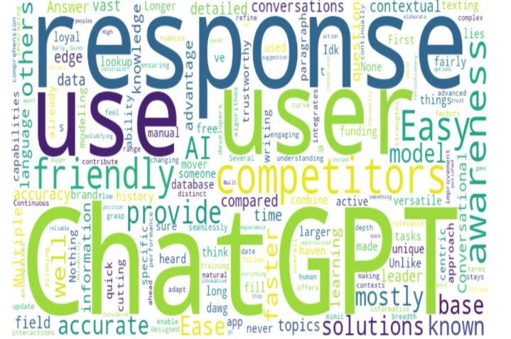
WORD CLOUD: In your own words, what do you believe is ChatGPT’s unique advantage compared to its competitors?

Slide 19
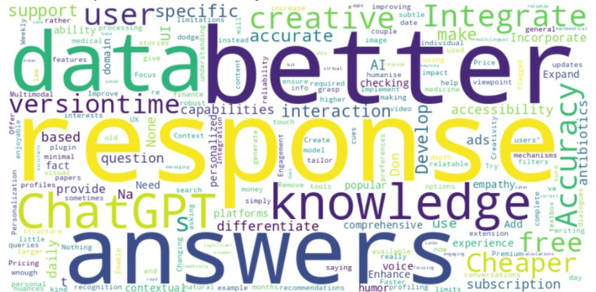
WORD CLOUD: In your own words, what do you believe is ChatGPT’s unique advantage compared to its competitors?

Slide 20

Thank you

